Slide 1
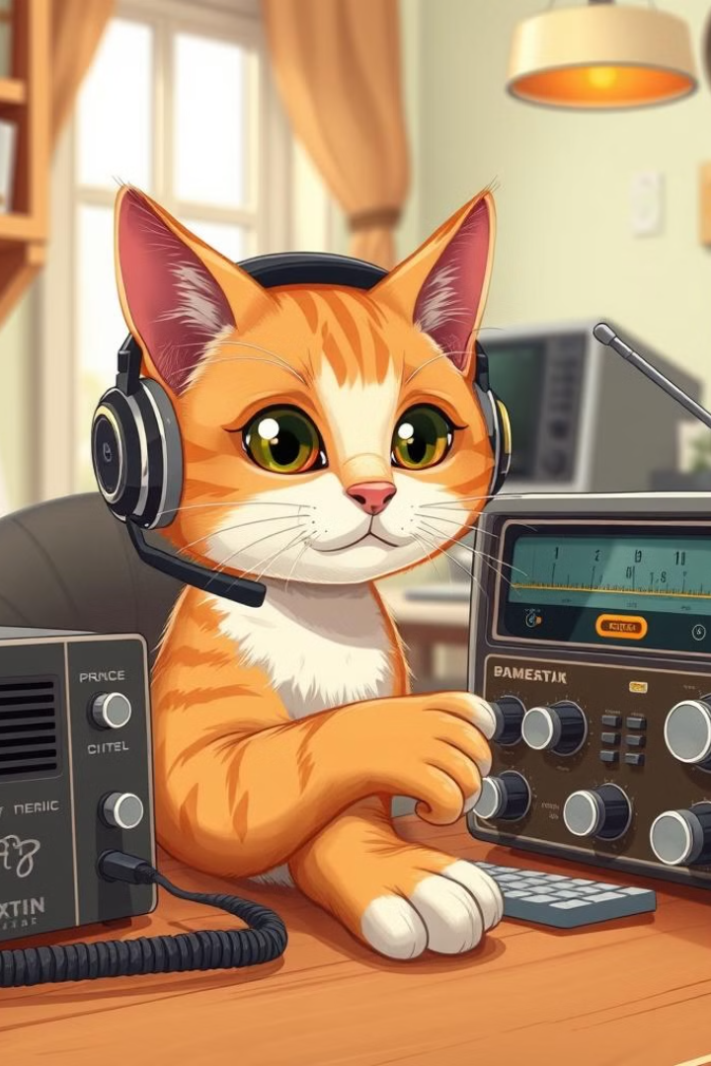
Amateur Radio
What it's about and why it might be interesting for you
Michael Clemens, DK1MI / N1BSD
https://dk1mi.radio

Slide 2
What is Amateur Radio?
Amateur Radio, also known as Ham Radio, is the use of the radio frequency spectrum for purposes of
Non-commercial exchange of messages
Wireless experimentation
Private recreation
Radio sport
Contesting
Emergency communications
and ultimately to enter the mother of rabbit holes!

Slide 3
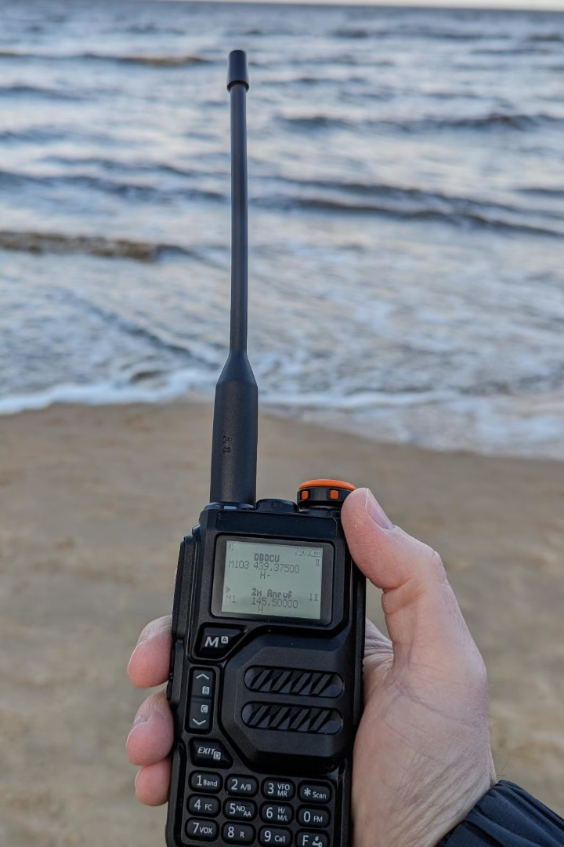




What do I need?
License
Transceiver
To be able to transmit on Ham Radio frequencies, you need to study, take an exam and get licensed first.
A radio transceiver transmits and receives radio signals. It allows you to communicate with other hams on different frequencies.
Antenna
Accessories
An antenna is essential for transmitting and receiving radio waves effectively. The type of antenna you use depends on the frequency you want to operate on.
Everything else that is needed or helps to operate: microphone, power supply, amplifier, antenna tuner, computer software for digital modes etc.

Slide 4
What can I do as a Ham (and what not)?
As an amateur radio operator, you have a responsibility to use the radio spectrum responsibly and ethically. This means respecting other operators, following regulations, and avoiding interference with other services.
For example, you are not allowed to:
Transmit without a license on amateur radio bands
Transmit outside of the amateur radio bands you are licensed for
Encrypt your communication
Communicate without identifying yourself on a regular basis
Talk about specific topics (sex, religion, politics)
Transmit broadcast-like content
But … what can I do with my license?

Slide 5
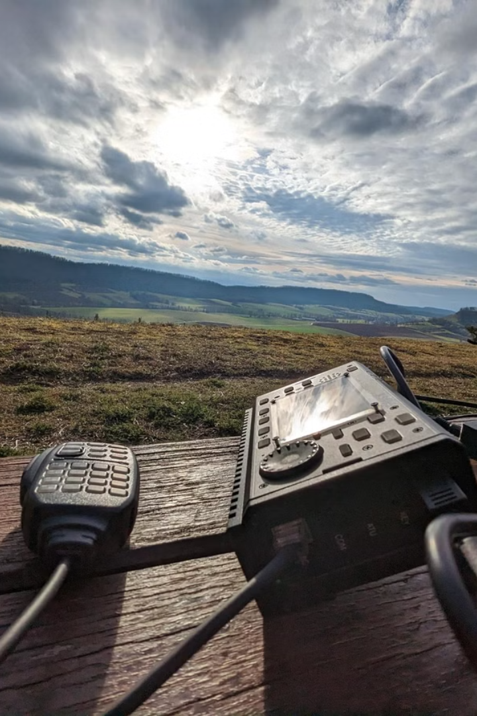




Popular Amateur Radio Activities
Contacting Other Hams
Contesting
Connecting with other radio enthusiasts worldwide, sharing stories, and building relationships.
Competing against other hams, trying to communicate with as many stations possible in a certain period of time
DXing (Long Distance)
Outdoor / Special Activities
Trying to communicate with hams as far away as possible, challenging your radio setup and skills.
Parks on the Air (POTA), Summits on the Air (SOTA), Field Day, Fox Hunting

Slide 6
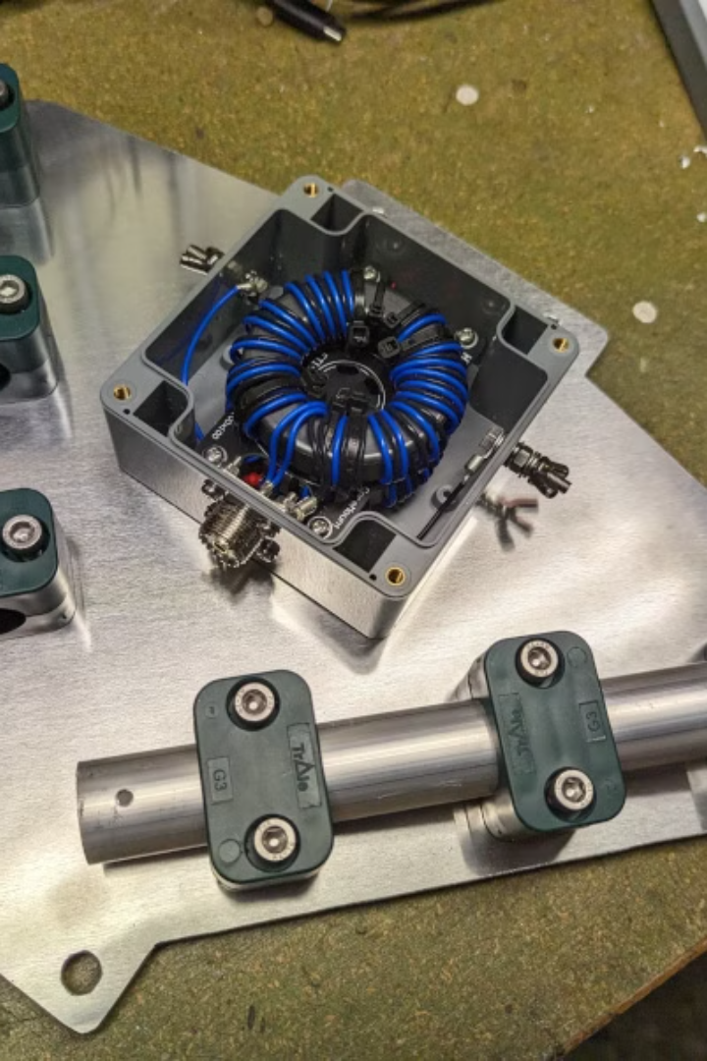




Popular Amateur Radio Activities
Hardware Tinkering
Software Development
Building antennas, transceivers, antenna rotors, amplifiers etc.
Developing (open source) logging software, SDR applications, helper scripts, analysis tools etc.
Emergency Communication
Satellite Communications
Preparing for emergencies, providing communication in case of emergencies
Using low orbit (incl. the ISS) and geostationary satellites as repeaters

Slide 7
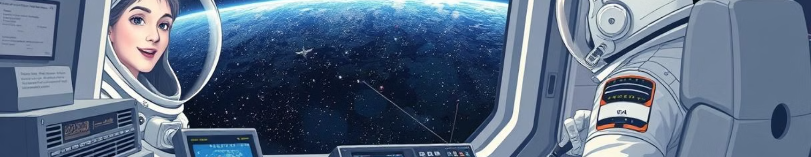




Unique and Interesting Contacts
Airborne Contacts
Maritime Connections
Space Communication
Polar Expeditions
Communicating with pilots in airliners while they're in flight.
Chatting e.g. with machinists on oil tankers at sea.
Rare opportunities to contact astronauts or cosmonauts.
Connecting with researchers at stations in Antarctica.

Slide 8
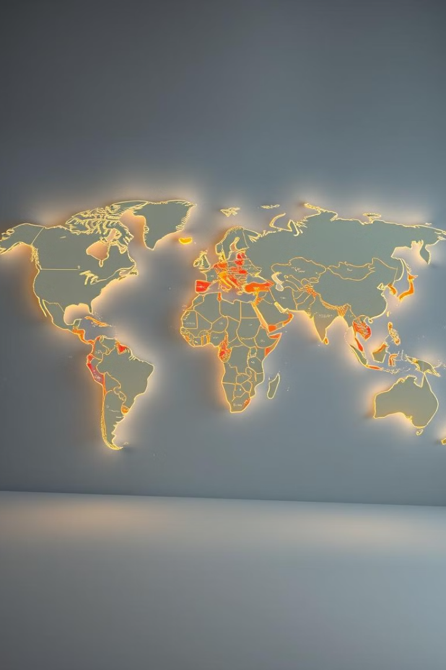




Geography, Geophysics and Cultural Exchange
Learning About New Places
Direct Cultural Exchange
Making contact with stations in unfamiliar locations prompts research into their geography and culture, expanding one's knowledge of the world.
Conversations with radio operators from different countries provide firsthand insights into their lives, customs, and local environments.
QSL Card Collection
Geophysics
Exchanging QSL cards, which confirm radio contacts, serves as a tangible reminder of connections made and places reached through the airwaves.
Most types of radio communication depend heavily on the ionosphere. Space weather and geophysics are an important part of the hobby.

Slide 9
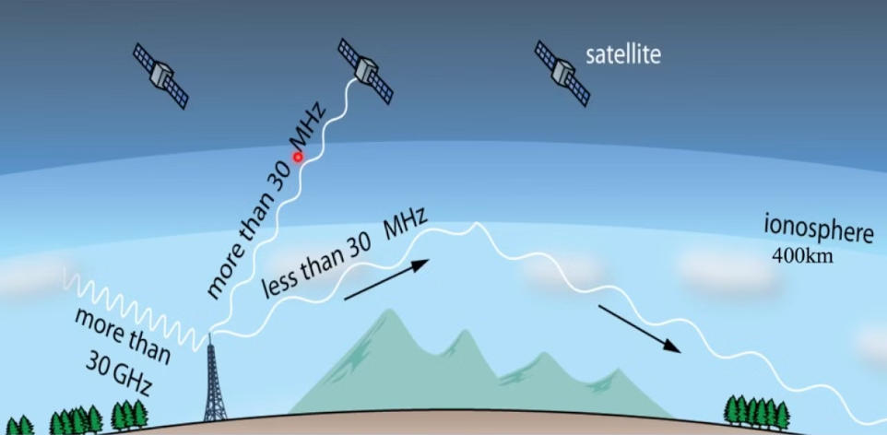
How does my Signal reach the other Station?
Radio waves propagate via
Line of Sight
Ground Wave
Ionosphere
Moon Bounce / Earth-Moon-Earth
Meteor Scatter (exploits the ionized trails of meteors during atmospheric entry)
Rain / Plane Scatter
(image taken from https://www.youtube.com/watch?v=CPsWRbxp9pw)

Slide 10





Modes of Communication
CW (Morse Code)
SSB (Single Sideband)
A classic mode of communication, using short and long tones to represent letters and numbers.
A voice communication mode that allows long-distance conversations.
FM (Frequency Modulation)
Digital Modes
A commonly used mode for local communication with clear voice transmission.
Computer-to-computer communication with low power requirements and error correction (Images, Text, Video). Might still work when voice communication would be impossible

Slide 11
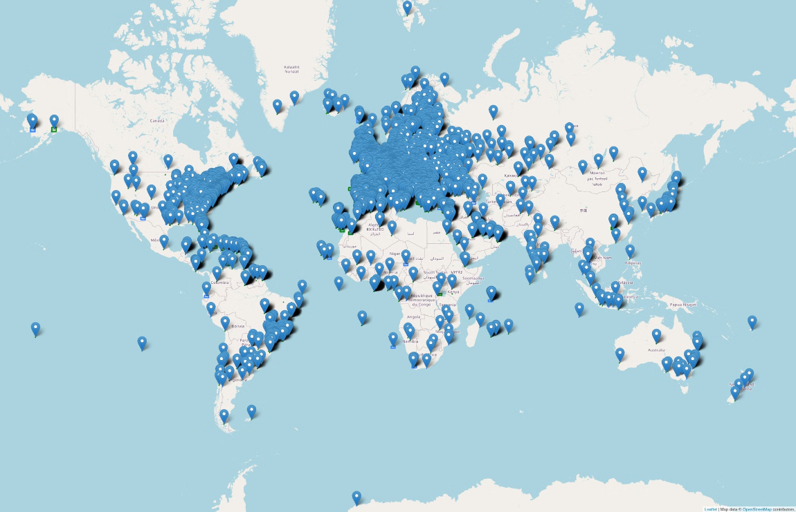
How far can you go (with a modest station)?
(map of all my voice communications via shortwave or satellite since 2019)

Slide 12
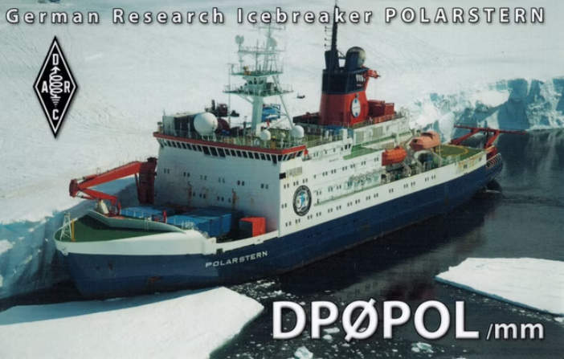
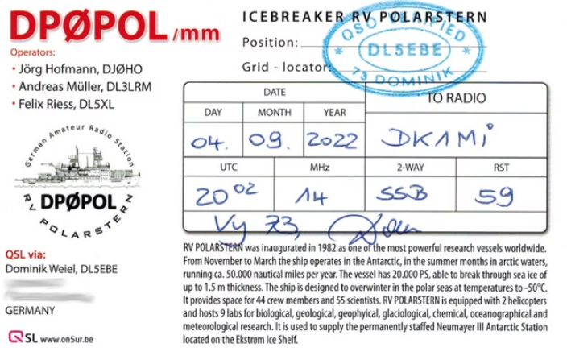
QSL Cards: DP0POL/MM

Slide 13
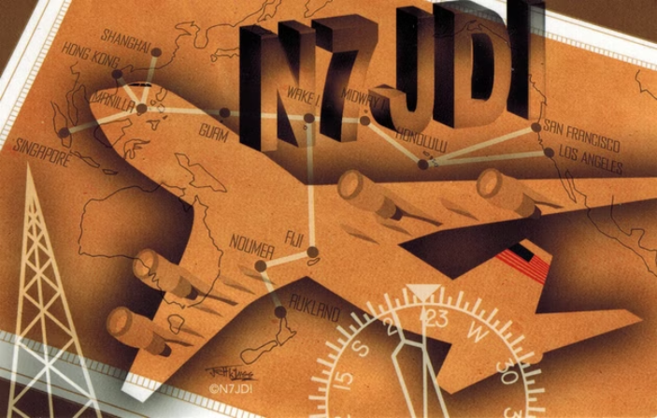
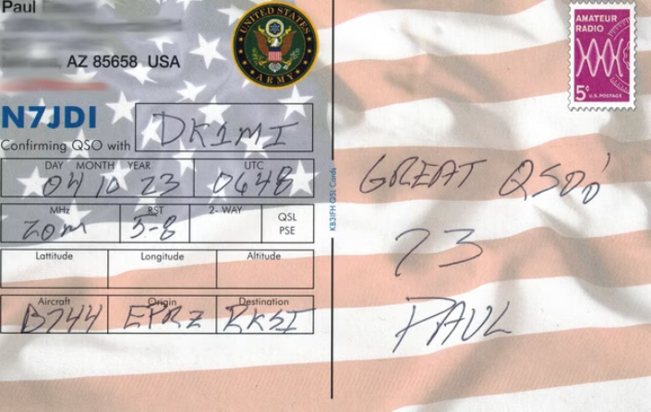
QSL Cards: N7JDI/AM

Slide 14
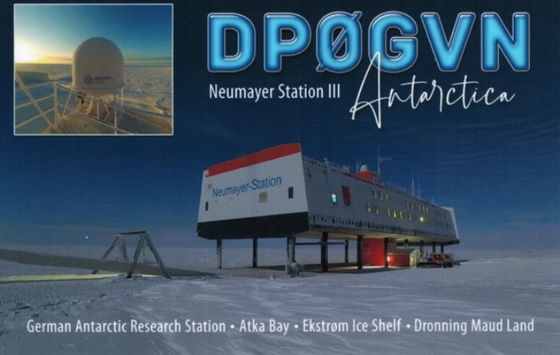
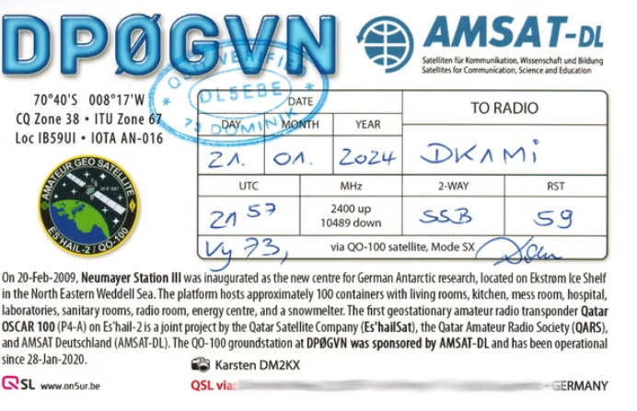
QSL Cards: DP0GVN via QO-100

Slide 15
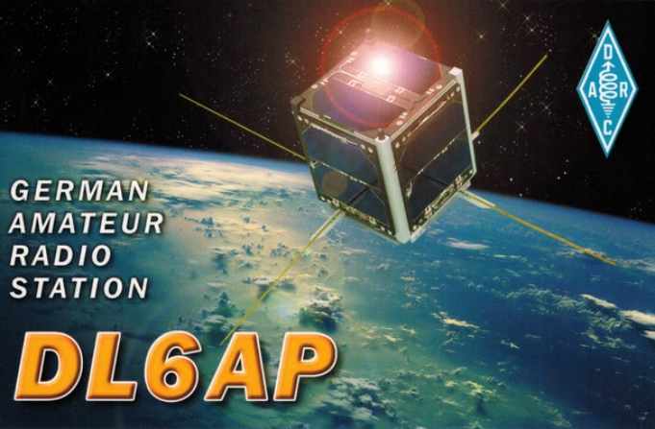
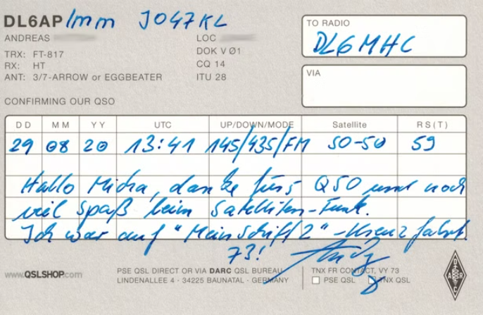
QSL Cards: DL6AP/MM via SO-50

Slide 16
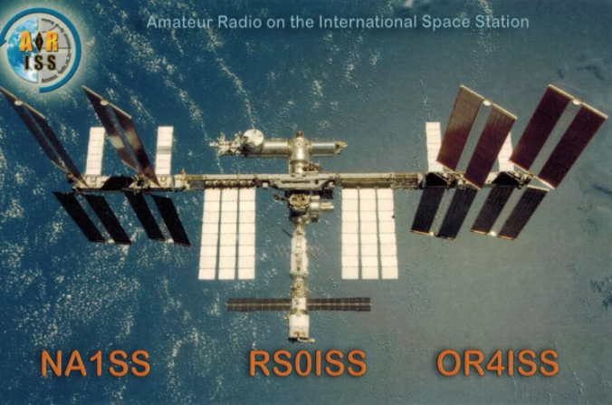
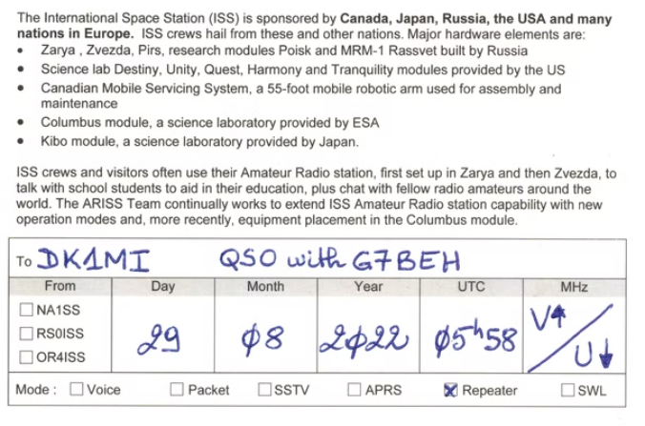
QSL Cards: G7BEH via the ISS

Slide 17
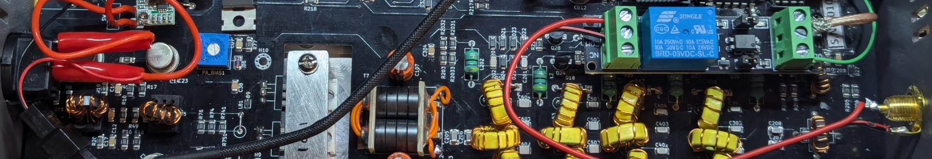
What Projects can you do?
A lot! Here are some examples of what I have made so far:
Hardware Projects:
Construction of a M0PLK Delta Loop Antenna
Building a LEO SAT ground station: 70cm Eggbeater Antenna
The QubeDX - a CubeSat-style enclosure for two QDX digi mode tranceiver
Software Projects:
qrzlogger: A python application to log QSOs directly from the CLI
DXPager: Get notified of rare DX via a pager

Slide 18
To sum it up: With Ham Radio you can
Make friends all over the world (but maybe not in your neighborhood)
Join a community of people you can trust (identification, codex)
Learn about geography, geophysics, space, electronics, 3D-Printing, metal working, software development etc.
Get ideas and inspirations for personal projects
Do things others aren't allowed to (build transmitters, use certain frequency bands, make use of satellites…)
Find reasons to get out into nature
Feel the excitement of communicating with people on the other side of the world without any infrastructure
Compete against others in contests
Collect cards from all over the world
Be social without social media and without direct exposure to actual people ;)

Slide 19
Ok, great - but what now?
Read about how to become a ham on your country's radio club website, e.g.:
  https://www.darc.de/
  https://www.ure.es/
  https://rsgb.org/
  https://www.arrl.org/
Optionally join a local radio club or an online community
Buy/lend/read study material
(Self-)study radio operating techniques, laws and HF electronics
Take an exam (most likely) at your country's regulatory authority
Buy/build/setup gear
Get on the air and make contacts!

Slide 20
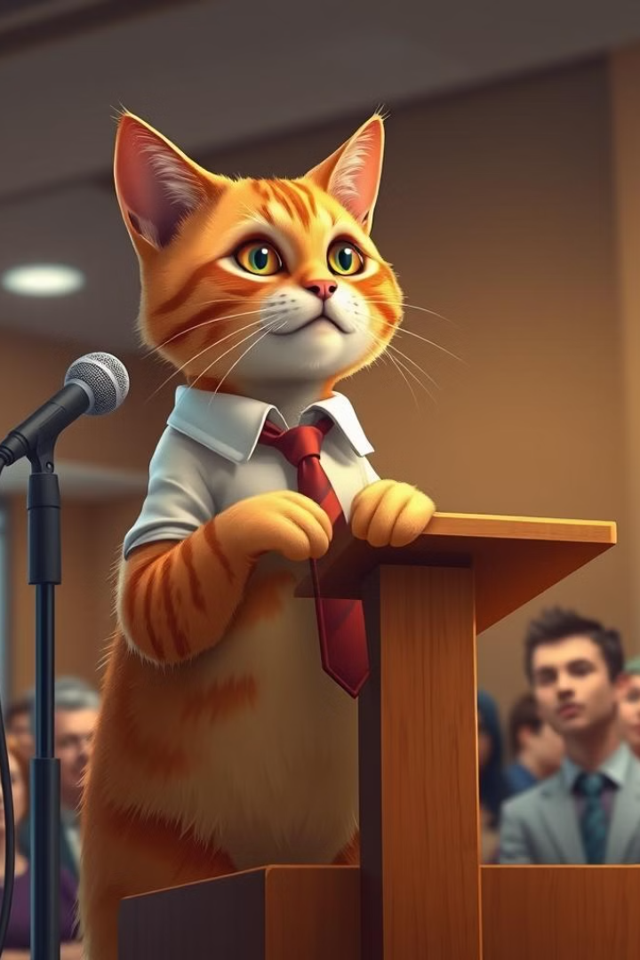
Thank You!
Feel free to ask any questions!

